Slide 1



Master thesis: Sentiment Analysis for Lebanese Arabizi Customers’ Reviews
Marwan Al Omari
Lebanese University
Center of Language Sciences and Communication
2019, MONDAY 29
Supervised by Dr. Moustafa Al-Hajj
Co-supervised by Dr. Amani Sabra

Slide 2
Presentation points
Introduction
Methodology
Experiment
Results
Conclusion

Slide 3
Introduction
Unstructured data of forty thousand exabytes in 2020 (Gantz and Reinsel, 2012)
Sentiment Analysis (SA)
Machine’s understanding and human language.
Positive, neutral, or negative (Duwairi et al., 2016)

Slide 4
Introduction (conti.)
Differentiation in language writing (Arab Social Media Report, 2017)
30% use Arabic characters
26% use Latin characters
15% use both Arabic and English
Language mixing popularizes new ways of writing (Aboelezz, 2012)
Arabizi is popular in Lebanon.
a system of writing Arabic using English characters. This term comes from two words “arabi” (Arabic) and “Engliszi” (English). (Yaghan, 2008, p. 39).
82% confirmed using Arabizi, and 17% does not used it out of respect for the Quran (American University survey in Cairo, 2011)

Slide 5
Problem statement
Unavailability of SA tools for processing Arabizi language system
Recognizing Arabizi internet users
Helping businesses on enhancing the qualities of services.

Slide 6
Purpose of the Study
Credit Arabizi users’ feelings and thoughts
Highlighting underpinning challenges for future work.
further research studies on benchmark dataset
Experimenting machine capabilities.
Knowledge-making and data-driven decision.

Slide 7
Research Questions
1. What would be the best approach that fits the SA task?
2. Which data preprocessing techniques are suitable and available for natural language texts?
3. Which data features most fit the trained ML models?
4. Which LR model would be the best for SA task?

Slide 8
Research Hypotheses
1. ML models could classify Lebanese Arabizi texts in binary classes: positive or negative.
2. Dataset could construct from social media sites on pages of public and private services’ providers.
3. Private sector services’ providers exceed public (governmental) ones.
4. All experiments would show a very slight difference regarding the achieved results.
5. ML implementation exceeds rule-based classifier’s performance.

Slide 9
Limitations of the Study
The dataset written in Lebanese Arabizi script
The size of the dataset is small
Shortness of time and the heavy pressure

Slide 10
Challenges of the study
Language shift from Arabic to Arabizi for domination
Manual data collection
Lexicon-based analysis
Variety of writings in the dataset

Slide 11
Research contributions
Benchmark Dataset
Real-time tool for Arabizi SA
Experimenting logistic regression with hyperparameter tuning

Slide 12
Methodology: Research Design
Mixed quantitative, descriptive, and experimental.
Statistical using of ML and rule-based approaches
Describing characteristics of the corpus and the challenge.
Experimenting variables: sentiment ratings, dataset’s training and splitting percentages, training features, evaluation measures.

Slide 13
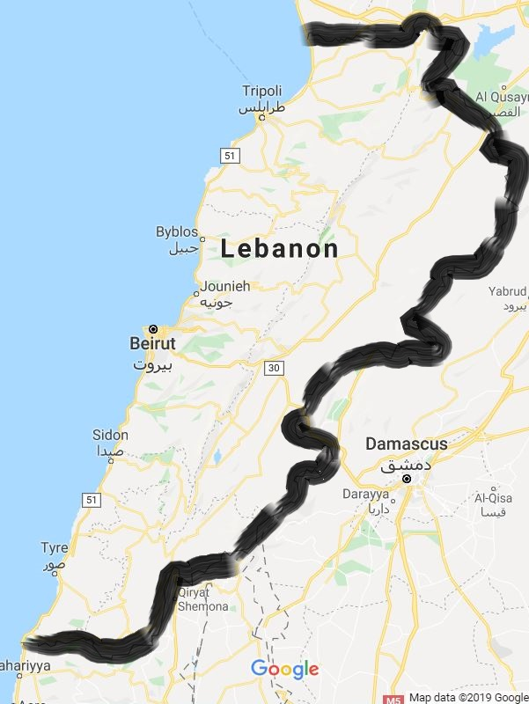
Methodology: Research Sample
The dataset collected from:
Facebook
Zomato (https://www.zomato.com/lebanon)
Google Map (https://maps.google.com)

Slide 14
Methodology: Research Sample(conti.)
The corpus contains 2635 reviews in Excel CSV (Comma Separated Values) UTF-8 format.
pagename | servicesector | review | review (in English) | rating
Al Saha Restaurant | private | La3de 7ilwe bs lakel mano tayyib | Beautiful ambiance but the food is not delicious | 2
Al Jawad Restaurant | private | sayer abadan ma tayib | it is no more delicious | 1
Shadi Najjar Store | private | Walla mnih | Wallah good | 5
Hayat Doner Alturki | private | Ktir tayeb | Very delicious | 4
Ahwak | private | 7aramiye | Thieves | 1

Slide 15
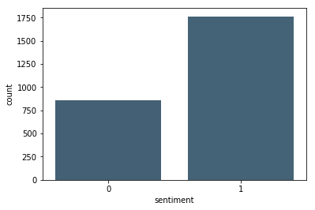
Methodology: Data Preprocessing and Filtering
Removal of reviews with “neutral” sentiment
3-star reviews dropped to avoid confusion.
Ratings’ Encodings
1755 Reviews with values of 5s and 4s encoded as 1 (positive sentiment)
880 Reviews with values of 1s and 2s encoded as 0 (negative sentiment).
Data splitting for training and testing
Random split 80% for training and 20% for testing.
Training set is 2098 examples with 684 negative and 1414 positive.
Testing set is 784 examples with 176 negative and 349 positive.

Slide 16
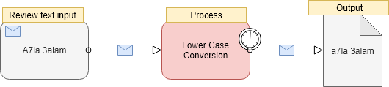
Methodology: Data Cleaning
Removal of User’s Related Information
To ensure maintenance of ethical standards
Lower Case Conversion

Slide 17
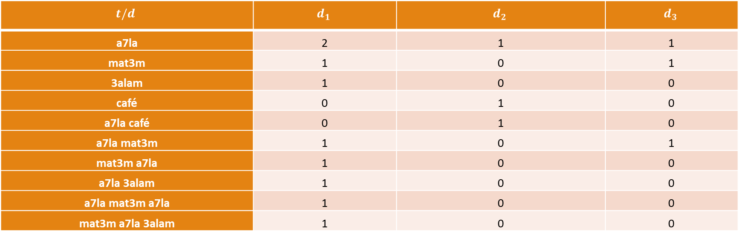
Reviews Representation Bag of Words (BoW) model
Assigning a weight to t based on the frequency of occurrences of t in d.
Example: “a7la mat3m a7la 3alam”, “A7la café”, and “A7la mat3m”.
$$t/d$$ | $$d_{1}$$ | $$d_{2}$$ | $$d_{3}$$
a7la | 2 | 1 | 1
mat3m | 1 | 0 | 1
3alam | 1 | 0 | 0
café | 0 | 1 | 0
a7la café | 0 | 1 | 0
a7la mat3m | 1 | 0 | 1
mat3m a7la | 1 | 0 | 0
a7la 3alam | 1 | 0 | 0
a7la mat3m a7la | 1 | 0 | 0
mat3m a7la 3alam | 1 | 0 | 0

Slide 18
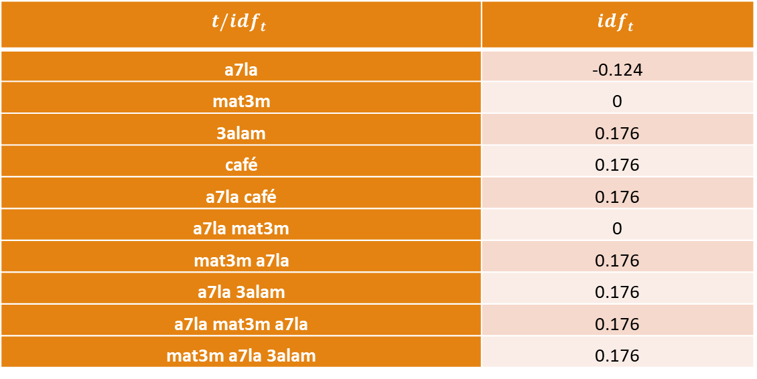

Term Frequency and Inverse Document Frequency (TF*IDF)
$tf$ is BoW and $idf$ recognizes less frequent terms with large weights, while low weight for frequent terms in documents ${idf}_{t} =log \frac{\#df}{1+\#{df}_{t}}$
$$t/{idf}_{t}$$ | $${idf}_{t}$$
a7la | -0.124
mat3m | 0
3alam | 0.176
café | 0.176
a7la café | 0.176
a7la mat3m | 0
mat3m a7la | 0.176
a7la 3alam | 0.176
a7la mat3m a7la | 0.176
mat3m a7la 3alam | 0.176

Slide 19
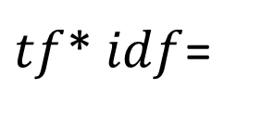
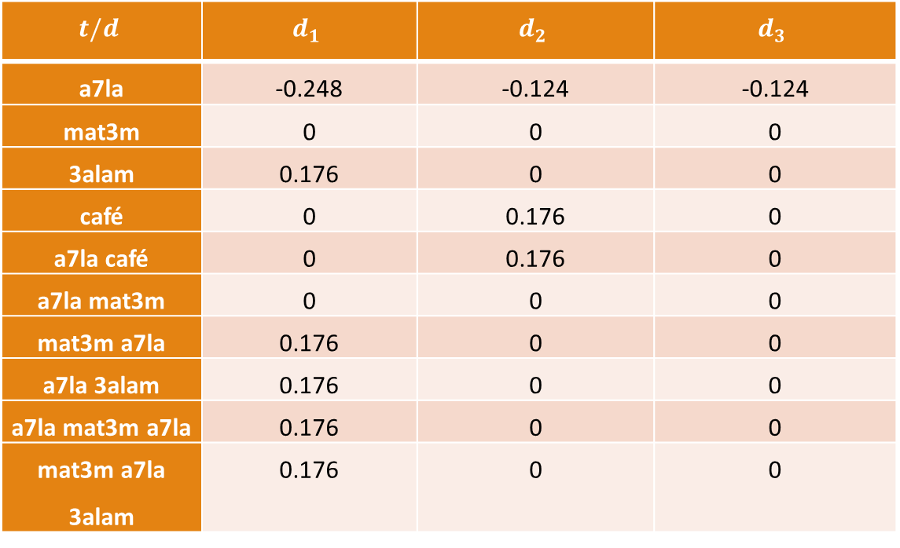
TF*IDF (conti)
$$t/d$$ | $$d_{1}$$ | $$d_{2}$$ | $$d_{3}$$
a7la | -0.248 | -0.124 | -0.124
mat3m | 0 | 0 | 0
3alam | 0.176 | 0 | 0
café | 0 | 0.176 | 0
a7la café | 0 | 0.176 | 0
a7la mat3m | 0 | 0 | 0
mat3m a7la | 0.176 | 0 | 0
a7la 3alam | 0.176 | 0 | 0
a7la mat3m a7la | 0.176 | 0 | 0
mat3m a7la 3alam | 0.176 | 0 | 0
$tf$* $idf$=

Slide 20
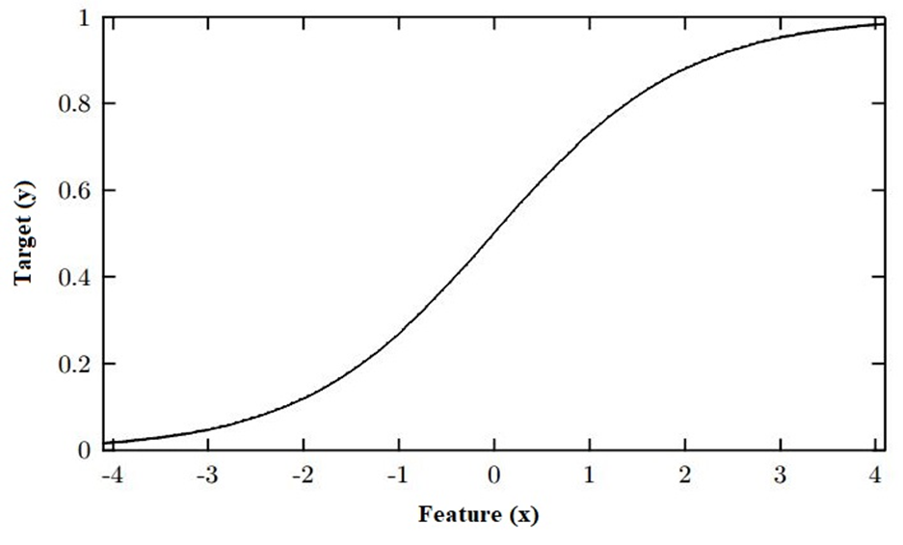
Research Tools: Logistic Regression
Logistic regression uses sigmoid function (S-shaped curve)
map +∞ and -∞ to scale between 0 and 1.

Slide 21
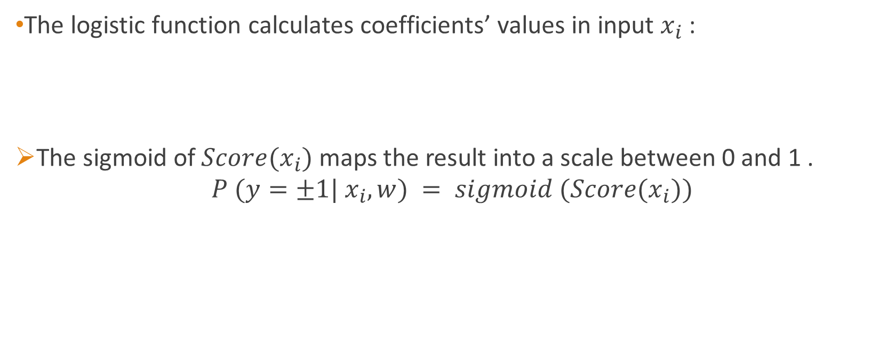
Logistic Regression
The logistic function calculates coefficients’ values in input $x_{i}$:
The sigmoid of $Score(x_{i})$ maps the result into a scale between 0 and 1 .
$$P (y=±1| x_{i},w) = sigmoid (Score(x_{i}))$$

Slide 22
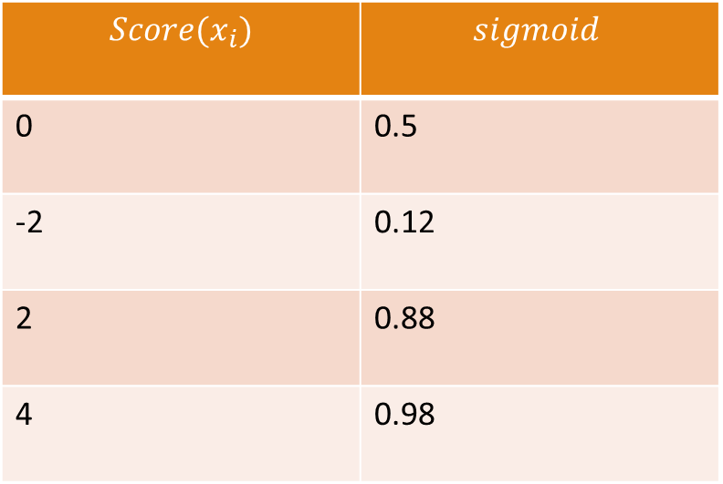
Logistic Regression (Example)
$$Score(x_{i})$$ | $$sigmoid$$
0 | 0.5
-2 | 0.12
2 | 0.88
4 | 0.98

Slide 23

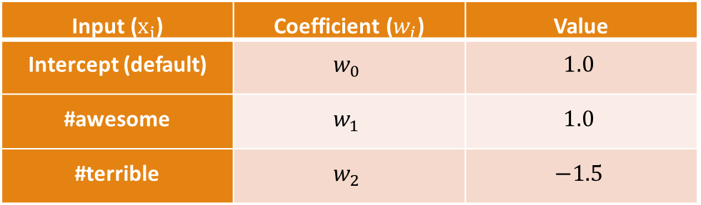
Logistic Regression (BoW Example)
Input ($x_{i}$) | Coefficient ($w_{i}$) | Value
Intercept (default) | $$w_{0}$$ | $$1.0$$
#awesome | $$w_{1}$$ | $$1.0$$
#terrible | $$w_{2}$$ | $$−1.5$$
$Score \left(x= “the food was awesome, but the service was terrible”\right)=1.0 \#awesome−1.5 \# terrible= −0.5$

Slide 24
SLCSAS (Science of Language and Communication Semantic Analysis System)
Program in Perl programming language developed by Moustafa Al-Hajj (2018)
linguistic grammar
dictionary
semantic map (categories)

Slide 25

SLCSAS (dictionary)
Built from 25% of the training set ($525$ reviews).
Category\Class | #Positive Class Terms Markers | #Positive Class Target Terms | #Negative Class Terms Markers | #Negative Class Target Terms
Delivery | 1 | 1 | 16 | 19
Costumer service | 22 | 21 | 24 | 22
Price | 14 | 18 | 9 | 10
Recommendation & Suggestion | 62 | 66 | 46 | 47
Administration | 99 | 126 | 65 | 86
Service | 33 | 41 | 38 | 42
Product | 106 | 131 | 64 | 84
Market | 36 | 40 | 34 | 32
Ambiance | 61 | 77 | 6 | 6
Overall | 45 | 88 | 37 | 51

Slide 26
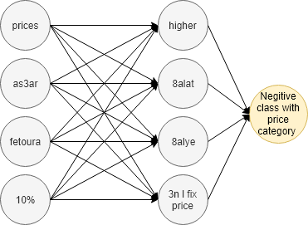
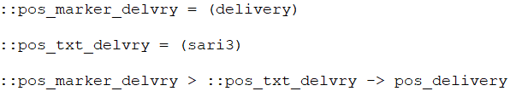
SLCSAS (Grammar rules)
11 categories in term marker and target text.
Examples
Complex
Simple
Complex Example of Grammar Rule in the Price Category of the Negative Class

Slide 27
SLCSAS (semantic map)

Slide 28
Research Procedure

Slide 29
Experiment: Machine Learning
Default LR settings
Parameter\architecture | BoW LR | TF*IDF LR
multi-level n-gram | unigram, bigram, and trigram (1,3)
inverse of regularization strength | 1
tolerance | 0.0001
maximum iterations | 100
Penalty | L2
hyperparameter tuning
Parameter\architecture | BoW LR pipeline | TF*IDF LR pipeline
multi-level n-gram | unigram (1,1) unigram and bigram (1,2) unigram, bigram, and trigram (1,3)
inverse of regularization strength | 100000, 10000, 1000, 100, 10, 1, 0.1, 0.01, 0.001, 0.0001
cross validation | 2
scoring | f1-score
Parameter\architecture | BoW LR | TF*IDF LR
multi-level n-gram | unigram (1,1) | unigram (1,1)
Inverse of regularization strength | 10 | 10
scoring | 0.896 | 0.909

Slide 30
Result: LR (default and hyperparameters tuning)
Unoptimized
optimized
BoW LR Model
BoW LR Model
Class\Measure | precision | recall | f1-score | support
0 | 0.84 | 0.62 | 0.71 | 176
1 | 0.83 | 0.94 | 0.88 | 349
Class\Measure | precision | recall | f1-score | support
0 | 0.86 | 0.69 | 0.76 | 176
1 | 0.86 | 0.94 | 0.90 | 349
TF*IDF LR Model
TF*IDF LR Model
Class\Measure | precision | recall | f1-score | support
0 | 0.82 | 0.63 | 0.71 | 176
1 | 0.83 | 0.93 | 0.88 | 349
Class\Measure | precision | recall | f1-score | support
0 | 0.80 | 0.75 | 0.77 | 176
1 | 0.88 | 0.90 | 0.89 | 349

Slide 31
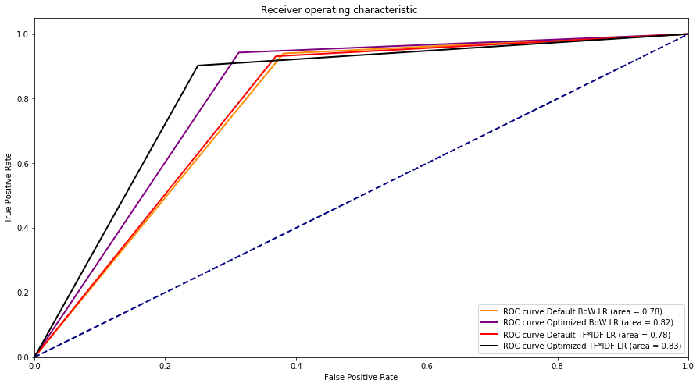
Experiment Summary

Slide 32
Result: SLCSAS
Performance of SLCSAS Classifier on 274 text reviews
Class\Measure | precision | recall | f1-score | retrieved | support
0 | 0.616 | 0.803 | 0.697 | 86 | 176
1 | 0.841 | 0.93 | 0.883 | 188 | 349

Slide 33
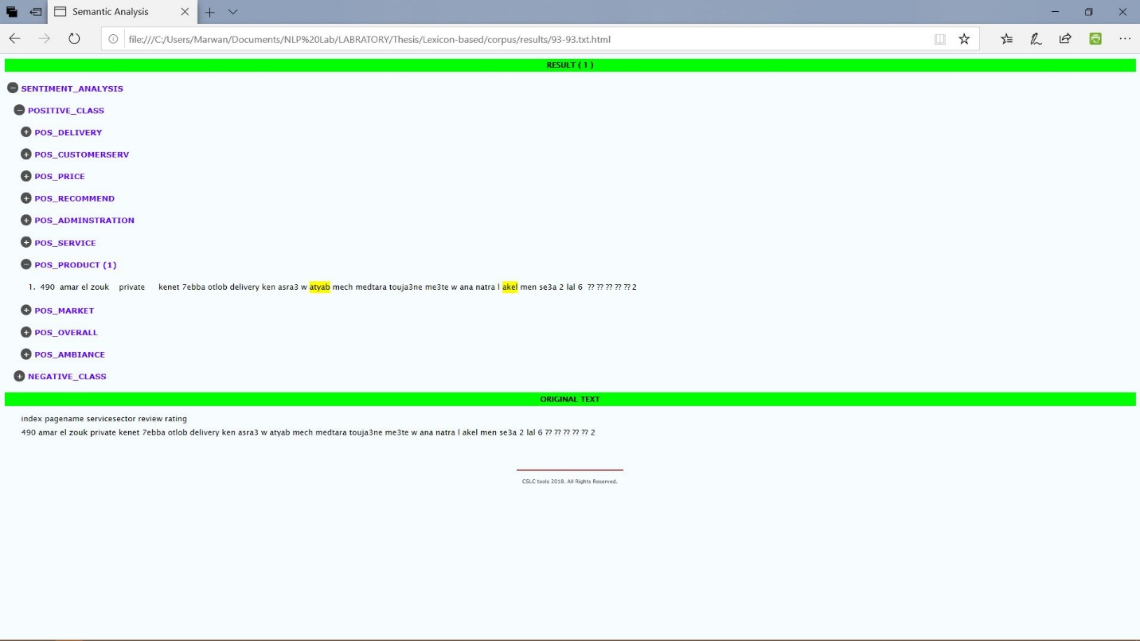

SLCSAS $F_{P}$ Example

Slide 34
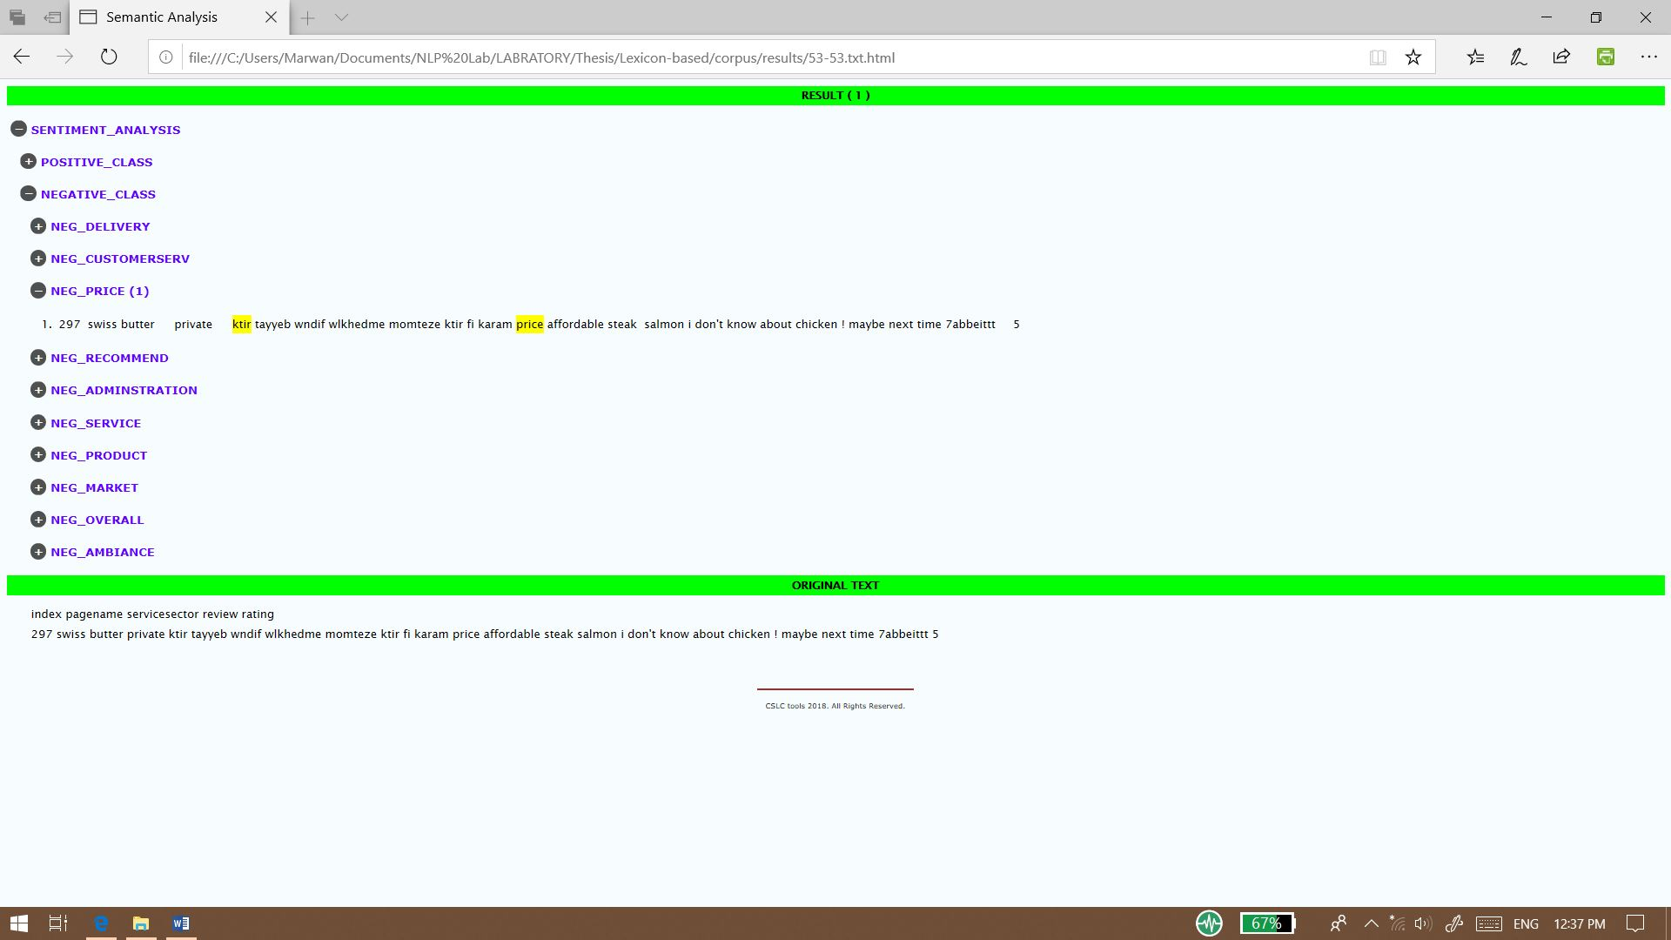

SLCSAS $F_{N}$ Example

Slide 35
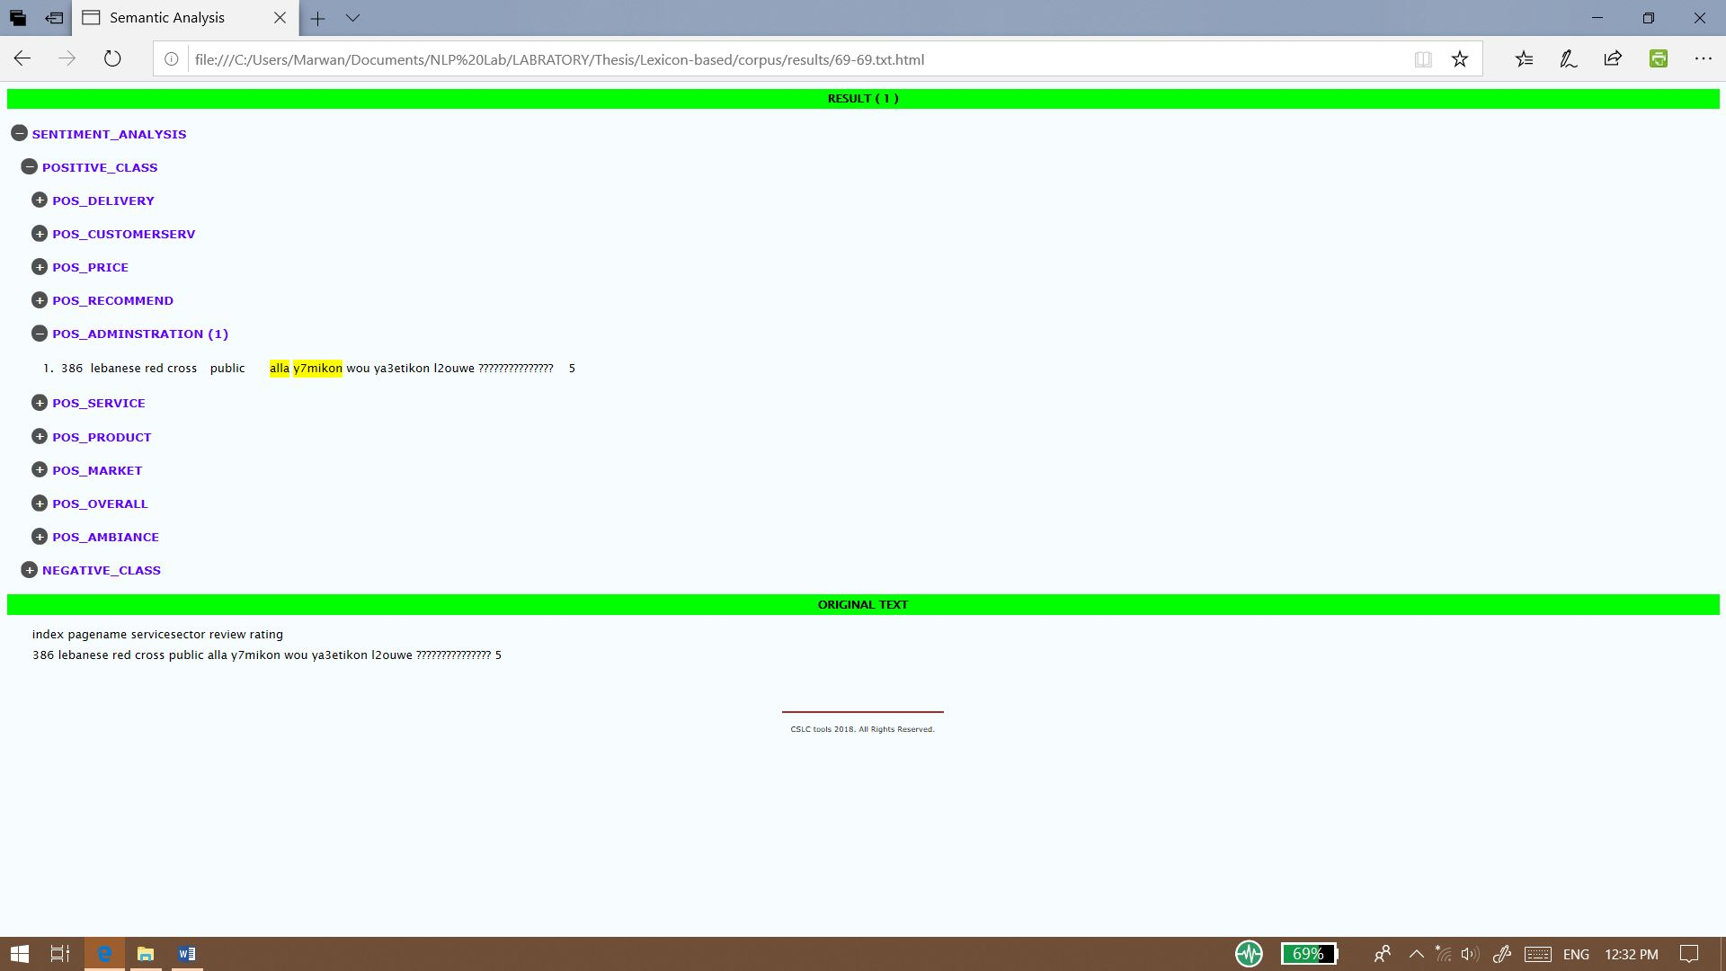

SLCSAS $T_{P}$ Example

Slide 36
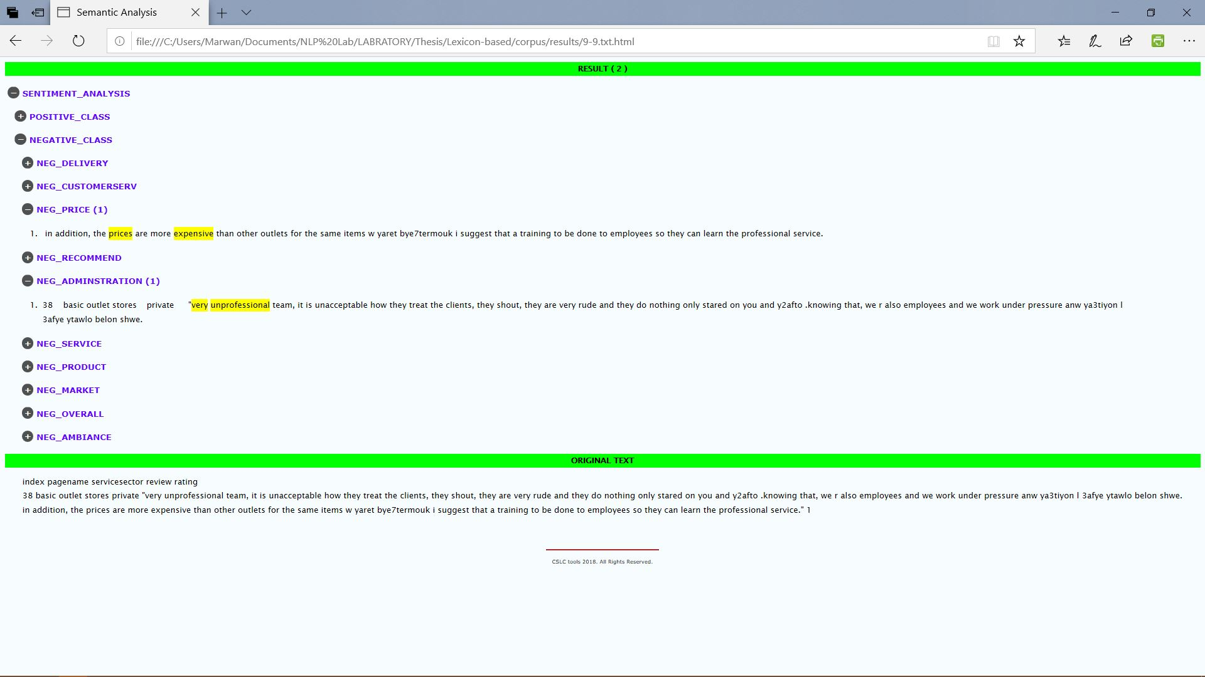

SLCSAS $T_{N}$ Example

Slide 37
Summary
Model | Class\Measure | precision | recall | f1-score | retrieved | support
Unoptimized BoW LR | 0 | 0.84 | 0.62 | 0.71 | 176 349
 | 1 | 0.83 | 0.94 | 0.88
Unoptimized TF*IDF LR | 0 | 0.82 | 0.63 | 0.71
 | 1 | 0.83 | 0.93 | 0.88
Optimized BoW LR | 0 | 0.86 | 0.69 | 0.76
 | 1 | 0.86 | 0.94 | 0.90
Optimized TF*IDF LR | 0 | 0.80 | 0.75 | 0.77
 | 1 | 0.88 | 0.90 | 0.89
SLCSAS | 0 | 0.616 | 0.803 | 0.697 | 86 | 176
 | 1 | 0.841 | 0.93 | 0.883 | 188 | 349

Slide 38

Conclusion
Research Questions
LR achieved better results than SLCSAS classifier.
Optimal results: optimized LR model with unigram TF*IDF feature and 10 $λ$.
Candidate Features are both unigrams BoW and TF*IDF.
data preprocessing steps:
Ratings’ encodings
data percentage split
lower casing
Removal of users’ personal information
1. What would be the best approach that fits the SA task?
2. Which data preprocessing techniques are suitable and available for natural language texts?
3. Which data features most fit the trained ML models?
4. Which LR model would be the best for SA task?

Slide 39
Conclusion (conti.)
Research Hypotheses
LR model is applicable to classify Arabizi reviews in positive or negative classes.
Dataset is constructed from public and private service providers.
Private service domination over public sector
Distinctive performance between ML and lexicon-based classifiers
ML remarks better result than rule-based approach
1. ML models could classify Lebanese Arabizi texts in binary classes: positive or negative.
2. Dataset could construct from social media sites on pages of public and private services’ providers.
3. Private sector services’ providers exceed public (governmental) ones.
4. All experiments would show a very slight difference regarding the achieved results.
5. ML implementation exceeds rule-based classifier’s performance.

Slide 40
Future Work
Expanding the corpus
scope of regions
Further tasks, as: part-of-speech tagging
Different ML and DL algorithms
Analyzing the whole training set for SLCSAS testing
Enhancing grammar rule and dictionary (max/min distance)
Different feature representation

Slide 41
Thanks dearly!

